Slide 2
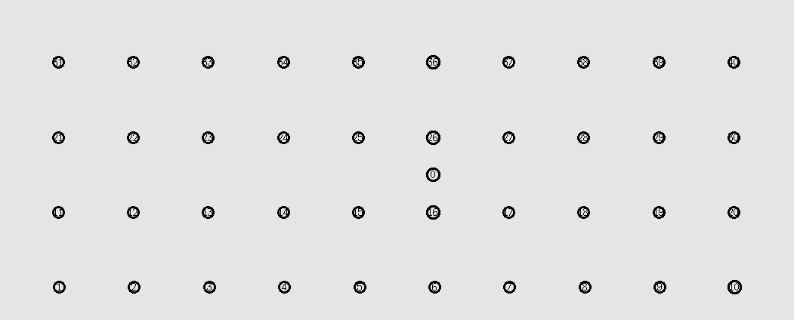

Slide 3
Nodes 40
Threshold | Packets in network | Coded Packets | Non-Coded Packets | Destination 1 Unique | Destination 2 Unique | Destination 3 Unique | Ratio
0 | 12974 | 11921 | 763 | 84 | 84 | 84 | 0.0194
0.1 | 12974 | 11921 | 763 | 84 | 84 | 84 | 0.0194
0.2 | 12974 | 11921 | 763 | 84 | 84 | 84 | 0.0194
0.3 | 25507 | 15939 | 9069 | 164 | 164 | 164 | 0.0193
0.4 | 31870 | 5419 | 25902 | 250 | 234 | 250 | 0.023
0.5 | 32682 | 1621 | 30617 | 250 | 250 | 250 | 0.0229
0.6 | 33908 | 38 | 33119 | 250 | 249 | 250 | 0.0221

Slide 4
Threshold | Packets in network | Coded Packets | Non-Coded Packets | Destination 1 Unique | Destination 2 Unique | Destination 3 Unique | Ratio
0.3 | 25507 | 15939 | 9069 | 164 | 164 | 164 | 0.0193
0.31 | 24987 | 14845 | 9592 | 161 | 159 | 161 | 0.0193
0.32 | 24973 | 13882 | 10647 | 161 | 161 | 161 | 0.0193
0.33 | 25837 | 14349 | 11000 | 169 | 169 | 169 | 0.0196
0.34 | 26171 | 13627 | 12107 | 149 | 170 | 149 | 0.0179
0.35 | 30616 | 13893 | 15922 | 222 | 222 | 222 | 0.0218
0.36 | 31987 | 14017 | 17239 | 233 | 240 | 233 | 0.0221
0.37 | 32392 | 12204 | 19464 | 250 | 238 | 250 | 0.0228
0.38 | 31885 | 8397 | 22788 | 250 | 222 | 250 | 0.0226
0.39 | 32274 | 6705 | 24852 | 250 | 238 | 250 | 0.0229
0.4 | 31870 | 5419 | 25902 | 250 | 234 | 250 | 0.023

Slide 5
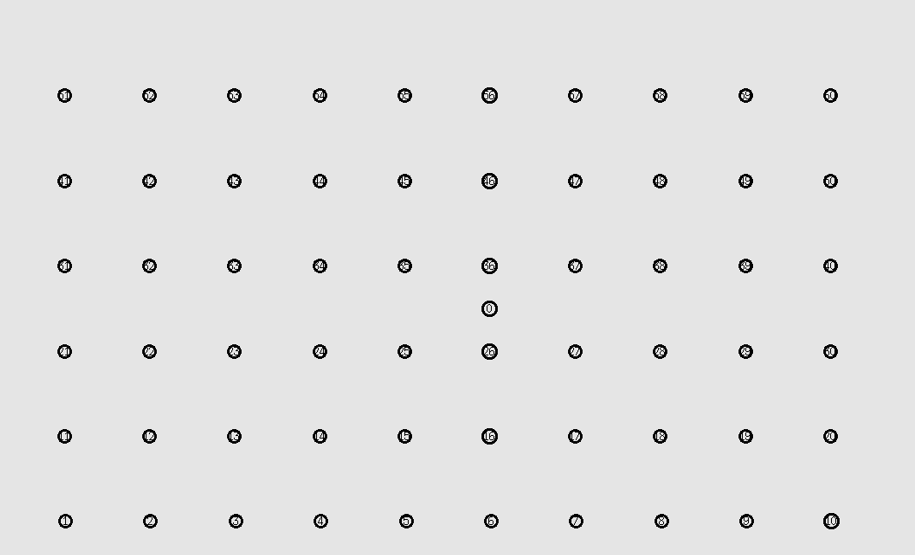

Slide 6
Nodes 60
Threshold | Packets in network | Coded Packets | Non-Coded Packets | Destination 1 Unique | Destination 2 Unique | Destination 3 Unique | Ratio
0 | 1989 | 1264 | 723 | 1 | 1 | 1 | 0.0015
0.1 | 1989 | 1264 | 723 | 1 | 1 | 1 | 0.0015
0.2 | 1989 | 1264 | 723 | 1 | 1 | 1 | 0.0015
0.3 | 2230 | 1284 | 938 | 2 | 2 | 2 | 0.0027
0.4 | 49897 | 8049 | 41288 | 250 | 243 | 250 | 0.0149
0.5 | 50444 | 2418 | 47612 | 250 | 250 | 250 | 0.0149
0.6 | 51870 | 37 | 51093 | 250 | 250 | 250 | 0.0145

Slide 7
Threshold | Packets in network | Coded Packets | Non-Coded Packets | Destination 1 Unique | Destination 2 Unique | Destination 3 Unique | Ratio
0.3 | 2230 | 1284 | 938 | 2 | 2 | 2 | 0.0027
0.31 | 2298 | 1322 | 968 | 2 | 2 | 2 | 0.0026
0.32 | 2298 | 1322 | 968 | 2 | 2 | 2 | 0.0026
0.33 | 2298 | 1322 | 968 | 2 | 2 | 2 | 0.0026
0.34 | 16200 | 7306 | 8674 | 65 | 65 | 65 | 0.012
0.35 | 17405 | 7536 | 9609 | 73 | 73 | 73 | 0.0126
0.36 | 17389 | 7240 | 9900 | 73 | 73 | 73 | 0.0126
0.37 | 50357 | 16642 | 32995 | 250 | 246 | 250 | 0.0148
0.38 | 50097 | 13314 | 36116 | 250 | 248 | 250 | 0.0149
0.39 | 17470 | 4853 | 12396 | 79 | 74 | 79 | 0.0133
0.4 | 49897 | 8049 | 41288 | 250 | 243 | 250 | 0.0149

Slide 8
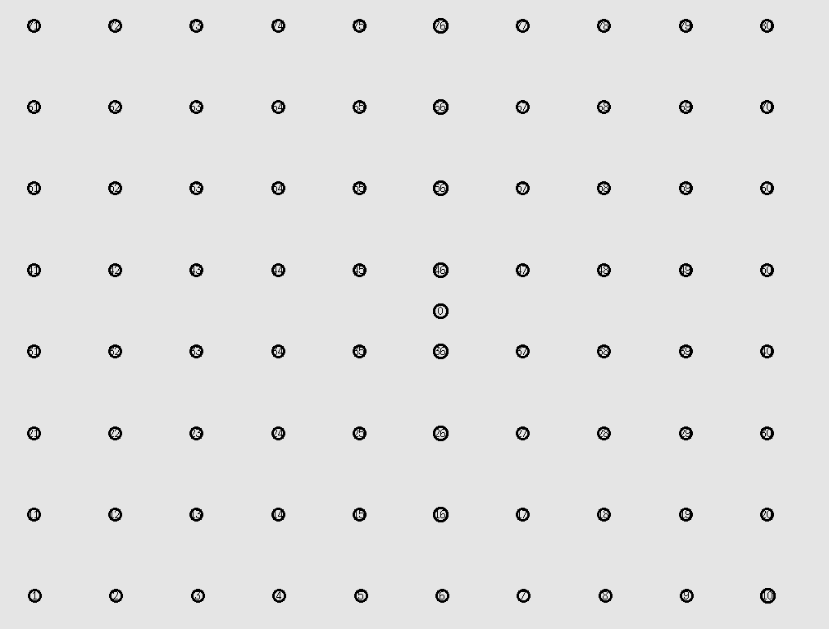

Slide 9
Nodes 80
Threshold | Packets in network | Coded Packets | Non-Coded Packets | Destination 1 Unique | Destination 2 Unique | Destination 3 Unique | Ratio
0 | 2053 | 1264 | 787 | 1 | 1 | 1 | 0.001461
0.1 | 2053 | 1264 | 787 | 1 | 1 | 1 | 0.001461
0.2 | 2053 | 1264 | 787 | 1 | 1 | 1 | 0.001461
0.3 | 2354 | 1272 | 1074 | 2 | 2 | 2 | 0.002549
0.4 | 67116 | 12235 | 54254 | 250 | 250 | 250 | 0.011175
0.5 | 67700 | 3645 | 63580 | 250 | 250 | 250 | 0.011078
0.6 | 68877 | 153 | 68043 | 250 | 250 | 250 | 0.010889

Slide 10
Threshold | Packets in network | Coded Packets | Non-Coded Packets | Destination 1 Unique | Destination 2 Unique | Destination 3 Unique | Ratio
0.3 | 2354 | 1272 | 1074 | 2 | 2 | 2 | 0.002549
0.31 | 2354 | 1272 | 1074 | 2 | 2 | 2 | 0.002549
0.32 | 2354 | 1272 | 1074 | 2 | 2 | 2 | 0.002549
0.33 | 2354 | 1272 | 1074 | 2 | 2 | 2 | 0.002549
0.34 | 2354 | 1272 | 1074 | 2 | 2 | 2 | 0.002549
0.35 | 2354 | 1272 | 1074 | 2 | 2 | 2 | 0.002549
0.36 | 2354 | 1272 | 1074 | 2 | 2 | 2 | 0.002549
0.37 | 67612 | 22200 | 44752 | 250 | 250 | 250 | 0.011093
0.38 | 67301 | 17362 | 49303 | 250 | 250 | 250 | 0.011144
0.39 | 67187 | 16102 | 50483 | 250 | 250 | 250 | 0.011163
0.4 | 67116 | 12235 | 54254 | 250 | 250 | 250 | 0.011175

Slide 11
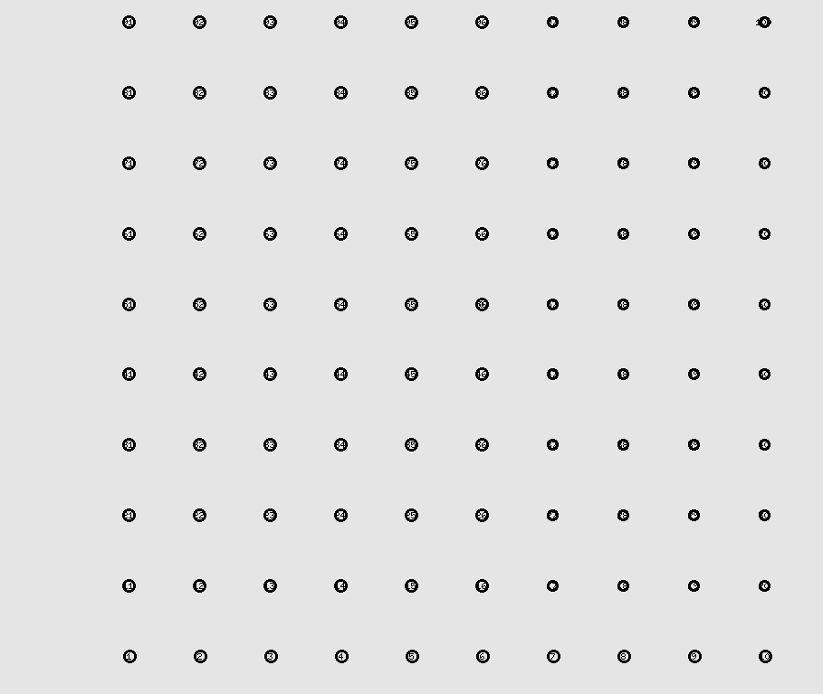

Slide 12
Nodes 100
Threshold | Packets in network | Coded Packets | Non-Coded Packets | Destination 1 Unique | Destination 2 Unique | Destination 3 Unique | Ratio
0 | 54698 | 52357 | 1903 | 146 | 146 | 146 | 0.008008
0.1 | 54698 | 52357 | 1903 | 146 | 146 | 146 | 0.008008
0.2 | 54698 | 52357 | 1903 | 146 | 146 | 146 | 0.008008
0.3 | 85058 | 58982 | 25396 | 240 | 240 | 240 | 0.008465
0.4 | 85837 | 15836 | 69421 | 248 | 249 | 248 | 0.008679
0.5 | 86634 | 5163 | 81031 | 250 | 250 | 250 | 0.008657
0.6 | 87618 | 261 | 86623 | 250 | 250 | 250 | 0.00856

Slide 13
Threshold | Packets in network | Coded Packets | Non-Coded Packets | Destination 1 Unique | Destination 2 Unique | Destination 3 Unique | Ratio
0.3 | 85058 | 58982 | 25396 | 240 | 240 | 240 | 0.008465
0.31 | 71588 | 43083 | 27995 | 182 | 182 | 182 | 0.007627
0.32 | 82176 | 45251 | 36241 | 229 | 229 | 229 | 0.00836
0.33 | 84923 | 40122 | 44152 | 240 | 240 | 240 | 0.008478
0.34 | 83829 | 37088 | 46092 | 237 | 237 | 237 | 0.008482
0.35 | 84064 | 35428 | 47944 | 238 | 238 | 238 | 0.008494
0.36 | 85318 | 32611 | 52041 | 244 | 244 | 244 | 0.00858
0.37 | 85885 | 30403 | 54769 | 248 | 250 | 246 | 0.008663
0.38 | 85936 | 25364 | 59869 | 248 | 250 | 247 | 0.008669
0.39 | 85926 | 20982 | 64173 | 247 | 249 | 248 | 0.008659
0.4 | 85837 | 15836 | 69421 | 248 | 249 | 248 | 0.008679

Slide 14
Threshold | Packets in network | Coded Packets | Non-Coded Packets | Destination 1 Unique | Destination 2 Unique | Destination 3 Unique | Ratio
0.4 | 85837 | 15836 | 69421 | 248 | 249 | 248 | 0.008679
0.41 | 85898 | 13554 | 71721 | 247 | 250 | 249 | 0.008685
0.42 | 85969 | 10489 | 74962 | 250 | 250 | 250 | 0.008724
0.43 | 86027 | 8721 | 76783 | 250 | 250 | 250 | 0.008718
0.44 | 86245 | 8030 | 77745 | 250 | 250 | 250 | 0.008696
0.45 | 86348 | 7002 | 78919 | 250 | 250 | 250 | 0.008686
0.46 | 86364 | 6693 | 79225 | 250 | 250 | 250 | 0.008684
0.47 | 86471 | 6141 | 79917 | 250 | 250 | 250 | 0.008673
0.48 | 86362 | 5999 | 79928 | 250 | 250 | 250 | 0.008684
0.49 | 86641 | 5718 | 80464 | 250 | 250 | 250 | 0.008656
0.5 | 86634 | 5163 | 81031 | 250 | 250 | 250 | 0.008657

Slide 15
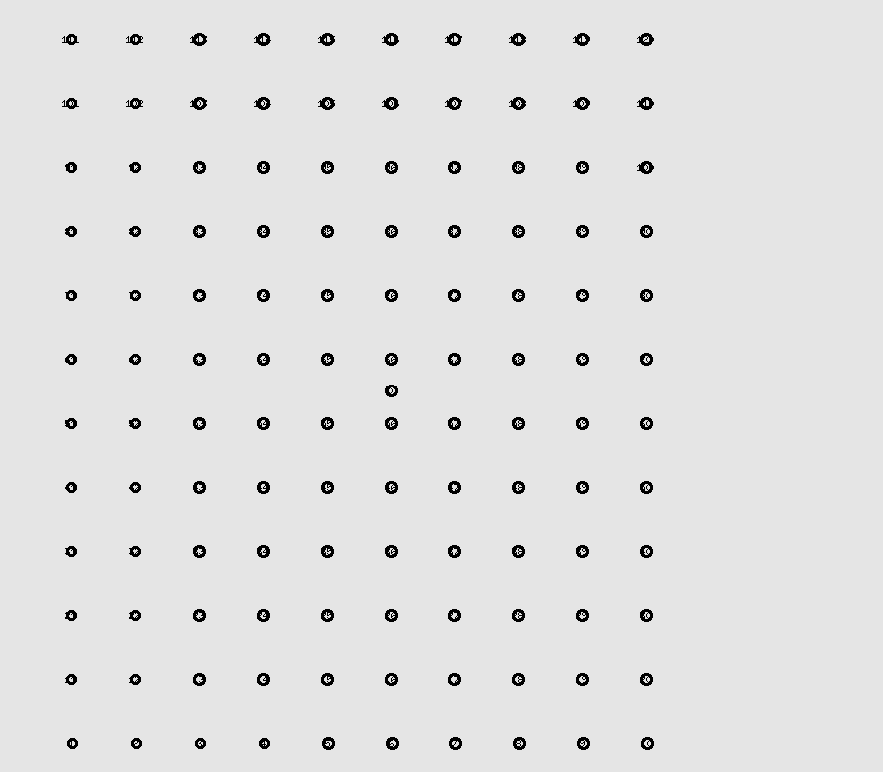

Slide 16
Nodes 120
Threshold | Packets in network | Coded Packets | Non-Coded Packets | Destination 1 Unique | Destination 2 Unique | Destination 3 Unique | Ratio
0 | 2208 | 1264 | 942 | 1 | 1 | 1 | 0.0014
0.1 | 2208 | 1264 | 942 | 1 | 1 | 1 | 0.0014
0.2 | 2208 | 1264 | 942 | 1 | 1 | 1 | 0.0014
0.3 | 4887 | 3052 | 1828 | 2 | 2 | 2 | 0.0012
0.4 | 102552 | 20198 | 81752 | 250 | 250 | 250 | 0.0073
0.5 | 102955 | 4890 | 97622 | 250 | 250 | 250 | 0.0073
0.6 | 104396 | 346 | 103349 | 250 | 250 | 250 | 0.0072

Slide 17
Threshold | Packets in network | Coded Packets | Non-Coded Packets | Destination 1 Unique | Destination 2 Unique | Destination 3 Unique | Ratio
0.4 | 102552 | 20198 | 81752 | 250 | 250 | 250 | 0.0073
0.41 | 34699 | 6877 | 27632 | 78 | 78 | 78 | 0.0067
0.42 | 102781 | 13241 | 89072 | 250 | 247 | 250 | 0.0073
0.43 | 102870 | 9939 | 92436 | 250 | 249 | 250 | 0.0073
0.44 | 102448 | 8114 | 93859 | 250 | 248 | 250 | 0.0073
0.45 | 103061 | 9210 | 93360 | 250 | 250 | 250 | 0.0073
0.46 | 102986 | 7772 | 94709 | 250 | 250 | 250 | 0.0073
0.47 | 45084 | 4341 | 40538 | 110 | 109 | 110 | 0.0073
0.48 | 103185 | 6213 | 96558 | 250 | 250 | 250 | 0.0073
0.49 | 102790 | 6462 | 95934 | 250 | 250 | 250 | 0.0073
0.5 | 102955 | 4890 | 97622 | 250 | 250 | 250 | 0.0073

Slide 18


Slide 19
Nodes 140
Threshold | Packets in network | Coded Packets | Non-Coded Packets | Destination 1 Unique | Destination 2 Unique | Destination 3 Unique | Ratio
0 | 2208 | 1264 | 942 | 1 | 1 | 1 | 0.0014
0.1 | 2208 | 1264 | 942 | 1 | 1 | 1 | 0.0014
0.2 | 2208 | 1264 | 942 | 1 | 1 | 1 | 0.0014
0.3 | 4887 | 3052 | 1828 | 2 | 2 | 2 | 0.0012
0.4 | 102552 | 20198 | 81752 | 250 | 250 | 250 | 0.0073
0.5 | 102955 | 4890 | 97622 | 250 | 250 | 250 | 0.0073
0.6 | 104396 | 346 | 103349 | 250 | 250 | 250 | 0.0072

Slide 20
Threshold | Packets in network | Coded Packets | Non-Coded Packets | Destination 1 Unique | Destination 2 Unique | Destination 3 Unique | Ratio
0.4 | 119311 | 22935 | 95765 | 238 | 248 | 248 | 0.006152
0.41 | 119532 | 19681 | 99223 | 237 | 249 | 249 | 0.006149
0.42 | 119934 | 15178 | 104251 | 243 | 250 | 250 | 0.006195
0.43 | 120112 | 11982 | 107624 | 240 | 250 | 250 | 0.006161
0.44 | 120592 | 10839 | 109244 | 248 | 250 | 250 | 0.006203
0.45 | 120789 | 10659 | 109677 | 250 | 250 | 250 | 0.006209
0.46 | 121046 | 9696 | 110892 | 250 | 250 | 250 | 0.006196
0.47 | 120596 | 7887 | 112297 | 247 | 250 | 250 | 0.006194
0.48 | 120495 | 7588 | 112410 | 248 | 250 | 250 | 0.006208
0.49 | 120561 | 7989 | 112139 | 250 | 250 | 250 | 0.006221
0.5 | 120631 | 6535 | 113599 | 249 | 249 | 250 | 0.006201

Slide 21
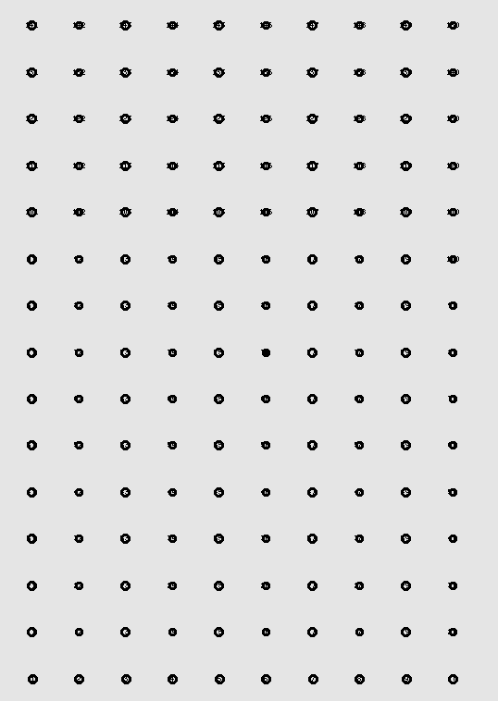

Slide 22
Nodes 150
Threshold | Packets in network | Coded Packets | Non-Coded Packets | Destination 1 Unique | Destination 2 Unique | Destination 3 Unique | Ratio
0 | 53848 | 51336 | 2287 | 80 | 80 | 80 | 0.0045
0.1 | 53848 | 51336 | 2287 | 80 | 80 | 80 | 0.0045
0.2 | 53848 | 51336 | 2287 | 80 | 80 | 80 | 0.0045
0.3 | 107900 | 79600 | 27732 | 190 | 190 | 190 | 0.0053
0.4 | 129624 | 25383 | 103710 | 243 | 249 | 249 | 0.0057
0.5 | 130671 | 6072 | 124174 | 250 | 249 | 249 | 0.0057
0.6 | 132694 | 212 | 131744 | 250 | 250 | 250 | 0.0057

Slide 23
Threshold | Packets in network | Coded Packets | Non-Coded Packets | Destination 1 Unique | Destination 2 Unique | Destination 3 Unique | Ratio
0.4 | 129624 | 25383 | 103710 | 243 | 249 | 249 | 0.0057
0.41 | 129785 | 21038 | 108138 | 245 | 249 | 249 | 0.0057
0.42 | 130256 | 17709 | 112007 | 249 | 246 | 246 | 0.0057
0.43 | 129979 | 13357 | 116125 | 249 | 247 | 247 | 0.0057
0.44 | 130279 | 11948 | 117860 | 249 | 247 | 247 | 0.0057
0.45 | 130729 | 11307 | 118947 | 250 | 249 | 249 | 0.0057
0.46 | 130515 | 11395 | 118632 | 250 | 249 | 249 | 0.0057
0.47 | 130789 | 9407 | 120907 | 249 | 250 | 250 | 0.0057
0.48 | 130791 | 8452 | 121893 | 250 | 250 | 250 | 0.0057
0.49 | 130840 | 8369 | 121985 | 250 | 250 | 250 | 0.0057
0.5 | 130671 | 6072 | 124174 | 250 | 249 | 249 | 0.0057

Slide 24
Moving Nodes

Slide 26
40 Nodes
Threshold | Packets in network | Coded Packets | Non-Coded Packets | Destination 1 Unique | Destination 2 Unique | Destination 3 Unique | Ratio
0 | 8213 | 6627 | 1505 | 26 | 26 | 26 | 0.009497
0.1 | 8338 | 6750 | 1509 | 26 | 26 | 26 | 0.009355
0.2 | 8149 | 6569 | 1515 | 24 | 24 | 24 | 0.008835
0.3 | 5801 | 3073 | 2725 | 2 | 2 | 2 | 0.001034
0.4 | 7756 | 1711 | 5945 | 24 | 24 | 24 | 0.009283
0.5 | 12200 | 1101 | 10946 | 64 | 63 | 64 | 0.015656
0.6 | 12584 | 50 | 12354 | 64 | 64 | 64 | 0.015257

Slide 27
40 Nodes
Threshold | Packets in network | Coded Packets | Non-Coded Packets | Destination 1 Unique | Destination 2 Unique | Destination 3 Unique | Ratio
0.3 | 5801 | 3073 | 2725 | 2 | 2 | 2 | 0.001034
0.31 | 4648 | 2692 | 1956 | 2 | 2 | 2 | 0.001291
0.32 | 5237 | 2067 | 3167 | 2 | 2 | 2 | 0.001146
0.33 | 4881 | 1713 | 3166 | 2 | 2 | 2 | 0.001229
0.34 | 5294 | 1684 | 3607 | 2 | 2 | 2 | 0.001133
0.35 | 5175 | 1577 | 3594 | 2 | 2 | 2 | 0.001159
0.36 | 5632 | 1595 | 4033 | 2 | 2 | 2 | 0.001065
0.37 | 7246 | 2374 | 4783 | 23 | 23 | 23 | 0.009522
0.38 | 7924 | 2361 | 5467 | 26 | 26 | 26 | 0.009844
0.39 | 7818 | 1900 | 5820 | 22 | 26 | 22 | 0.008954
0.4 | 7756 | 1711 | 5945 | 24 | 24 | 24 | 0.009283

Slide 29
80 Nodes
Threshold | Packets in network | Coded Packets | Non-Coded Packets | Destination 1 Unique | Destination 2 Unique | Destination 3 Unique | Ratio
0 | 10705 | 8865 | 1788 | 21 | 21 | 21 | 0.005885
0.1 | 10728 | 8900 | 1776 | 21 | 21 | 21 | 0.005872
0.2 | 10728 | 8820 | 1816 | 21 | 21 | 21 | 0.005872
0.3 | 6106 | 3129 | 2975 | 2 | 2 | 2 | 0.000983
0.4 | 19324 | 3533 | 15654 | 58 | 57 | 58 | 0.008953
0.5 | 19844 | 749 | 18997 | 58 | 59 | 58 | 0.008819
0.6 | 20219 | 29 | 20039 | 59 | 59 | 59 | 0.008754

Slide 30
80 Nodes
Threshold | Packets in network | Coded Packets | Non-Coded Packets | Destination 1 Unique | Destination 2 Unique | Destination 3 Unique | Ratio
0.3 | 6106 | 3129 | 2975 | 2 | 2 | 2 | 0.000983
0.31 | 5577 | 2463 | 3112 | 2 | 2 | 2 | 0.001076
0.32 | 5751 | 2709 | 3040 | 2 | 2 | 2 | 0.001043
0.33 | 5926 | 2356 | 3568 | 2 | 2 | 2 | 0.001012
0.34 | 5908 | 2199 | 3707 | 2 | 2 | 2 | 0.001016
0.35 | 5912 | 1868 | 4042 | 2 | 2 | 2 | 0.001015
0.36 | 5578 | 1471 | 4104 | 2 | 2 | 2 | 0.001076
0.37 | 18572 | 7901 | 10505 | 48 | 53 | 53 | 0.008292
0.38 | 19034 | 5570 | 13310 | 54 | 55 | 56 | 0.008669
0.39 | 18663 | 6157 | 12290 | 59 | 59 | 58 | 0.00943
0.4 | 19324 | 3533 | 15654 | 58 | 57 | 58 | 0.008953

Slide 32
120 Nodes
Threshold | Packets in network | Coded Packets | Non-Coded Packets | Destination 1 Unique | Destination 2 Unique | Destination 3 Unique | Ratio
0 | 6381 | 4622 | 1759 | 1 | 1 | 1 | 0.00047
0.1 | 6135 | 4359 | 1776 | 1 | 1 | 1 | 0.000489
0.2 | 5215 | 3421 | 1797 | 1 | 1 | 1 | 0.000575
0.3 | 16348 | 11838 | 4431 | 28 | 28 | 28 | 0.005138
0.4 | 12626 | 3080 | 9465 | 23 | 14 | 17 | 0.004277
0.5 | 31877 | 1870 | 29891 | 70 | 70 | 69 | 0.006556
0.6 | 31854 | 98 | 31581 | 69 | 69 | 69 | 0.006498

Slide 33
120 Nodes
Threshold | Packets in network | Coded Packets | Non-Coded Packets | Destination 1 Unique | Destination 2 Unique | Destination 3 Unique | Ratio
0.4 | 12626 | 3080 | 9465 | 23 | 14 | 17 | 0.004277
0.41 | 30049 | 5554 | 24294 | 68 | 61 | 64 | 0.006423
0.42 | 31828 | 4472 | 27220 | 70 | 70 | 70 | 0.006598
0.43 | 31887 | 4228 | 27521 | 70 | 70 | 70 | 0.006586
0.44 | 31798 | 3530 | 28157 | 70 | 70 | 70 | 0.006604
0.45 | 32257 | 2723 | 29380 | 70 | 71 | 71 | 0.006572
0.46 | 31778 | 3002 | 28657 | 69 | 70 | 70 | 0.006577
0.47 | 32212 | 2243 | 29838 | 71 | 71 | 70 | 0.006581
0.48 | 31880 | 2130 | 29633 | 69 | 70 | 70 | 0.006556
0.49 | 32395 | 1998 | 30281 | 71 | 71 | 71 | 0.006575
0.5 | 31877 | 1870 | 29891 | 70 | 70 | 69 | 0.006556

Slide 34
Time
40 Nodes Static
26 vs 31
Threshold | Packets in network | Coded Packets | Non-Coded Packets | Destination 1 Unique | Destination 2 Unique | Destination 3 Unique | Ratio
0 | 54698 | 52357 | 1903 | 146 | 146 | 146 | 0.008008
0.1 | 54698 | 52357 | 1903 | 146 | 146 | 146 | 0.008008
0.2 | 54698 | 52357 | 1903 | 146 | 146 | 146 | 0.008008
0.3 | 85058 | 58982 | 25396 | 240 | 240 | 240 | 0.008465
0.4 | 85837 | 15836 | 69421 | 248 | 249 | 248 | 0.008679
0.5 | 86634 | 5163 | 81031 | 250 | 250 | 250 | 0.008657
0.6 | 87618 | 261 | 86623 | 250 | 250 | 250 | 0.00856
Threshold | Packets in network | Coded Packets | Non-Coded Packets | Destination 1 Unique | Destination 2 Unique | Destination 3 Unique | Ratio
0 | 58173 | 54921 | 2749 | 156 | 156 | 155 | 0.008028
0.1 | 58173 | 54921 | 2749 | 156 | 156 | 155 | 0.008028
0.2 | 58173 | 54921 | 2749 | 156 | 156 | 155 | 0.008028
0.3 | 85308 | 58982 | 25646 | 240 | 240 | 240 | 0.00844
0.4 | 86087 | 15836 | 69671 | 248 | 249 | 248 | 0.008654
0.5 | 86884 | 5163 | 81281 | 250 | 250 | 250 | 0.008632
0.6 | 87868 | 261 | 86873 | 250 | 250 | 250 | 0.008536

Slide 35
26 vs 31
Threshold | Packets in network | Coded Packets | Non-Coded Packets | Destination 1 Unique | Destination 2 Unique | Destination 3 Unique | Ratio
0.3 | 85058 | 58982 | 25396 | 240 | 240 | 240 | 0.008465
0.31 | 71588 | 43083 | 27995 | 182 | 182 | 182 | 0.007627
0.32 | 82176 | 45251 | 36241 | 229 | 229 | 229 | 0.00836
0.33 | 84923 | 40122 | 44152 | 240 | 240 | 240 | 0.008478
0.34 | 83829 | 37088 | 46092 | 237 | 237 | 237 | 0.008482
0.35 | 84064 | 35428 | 47944 | 238 | 238 | 238 | 0.008494
0.36 | 85318 | 32611 | 52041 | 244 | 244 | 244 | 0.00858
0.37 | 85885 | 30403 | 54769 | 248 | 250 | 246 | 0.008663
0.38 | 85936 | 25364 | 59869 | 248 | 250 | 247 | 0.008669
0.39 | 85926 | 20982 | 64173 | 247 | 249 | 248 | 0.008659
0.4 | 85837 | 15836 | 69421 | 248 | 249 | 248 | 0.008679
Threshold | Packets in network | Coded Packets | Non-Coded Packets | Destination 1 Unique | Destination 2 Unique | Destination 3 Unique | Ratio
0.3 | 85308 | 58982 | 25646 | 240 | 240 | 240 | 0.00844
0.31 | 71838 | 43083 | 28245 | 182 | 182 | 182 | 0.0076
0.32 | 82426 | 45251 | 36491 | 229 | 229 | 229 | 0.008335
0.33 | 85173 | 40122 | 44402 | 240 | 240 | 240 | 0.008453
0.34 | 84079 | 37088 | 46342 | 237 | 237 | 237 | 0.008456
0.35 | 84682 | 35434 | 48542 | 239 | 239 | 239 | 0.008467
0.36 | 85568 | 32611 | 52291 | 244 | 244 | 244 | 0.008555
0.37 | 86135 | 30403 | 55019 | 248 | 250 | 246 | 0.008638
0.38 | 86186 | 25364 | 60119 | 248 | 250 | 247 | 0.008644
0.39 | 86176 | 20982 | 64423 | 247 | 249 | 248 | 0.008633
0.4 | 86087 | 15836 | 69671 | 248 | 249 | 248 | 0.008654

Slide 36
Time
100 Nodes Moving
26 vs 31
Threshold | Packets in network | Coded Packets | Non-Coded Packets | Destination 1 Unique | Destination 2 Unique | Destination 3 Unique | Ratio
0 | 9897 | 9013 | 884 | 0 | 0 | 0 | 0
0.1 | 53423 | 51275 | 1746 | 151 | 151 | 151 | 0.008479
0.2 | 57016 | 53111 | 3405 | 163 | 162 | 165 | 0.008594
0.3 | 64081 | 49356 | 14190 | 187 | 186 | 187 | 0.008739
0.4 | 60403 | 16970 | 42919 | 178 | 178 | 178 | 0.008841
0.5 | 60487 | 4393 | 55756 | 177 | 177 | 176 | 0.008762
0.6 | 60533 | 513 | 59503 | 176 | 176 | 176 | 0.008723
Threshold | Packets in network | Coded Packets | Non-Coded Packets | Destination 1 Unique | Destination 2 Unique | Destination 3 Unique | Ratio
0 | 11958 | 10876 | 1084 | 0 | 0 | 0 | 0
0.1 | 56078 | 53699 | 1946 | 165 | 151 | 151 | 0.008328
0.2 | 59926 | 55739 | 3616 | 172 | 172 | 171 | 0.008594
0.3 | 69949 | 54878 | 14440 | 203 | 203 | 204 | 0.008721
0.4 | 65754 | 21375 | 43746 | 193 | 193 | 192 | 0.00879
0.5 | 65742 | 8152 | 57219 | 192 | 192 | 192 | 0.008762
0.6 | 65754 | 2128 | 63068 | 191 | 190 | 191 | 0.008699

Slide 37
26 vs 31
Threshold | Packets in network | Coded Packets | Non-Coded Packets | Destination 1 Unique | Destination 2 Unique | Destination 3 Unique | Ratio
0.3 | 64081 | 49356 | 14190 | 187 | 186 | 187 | 0.008739
0.31 | 63847 | 44820 | 18508 | 187 | 187 | 186 | 0.008771
0.32 | 65076 | 44183 | 20283 | 189 | 189 | 189 | 0.008713
0.33 | 65097 | 40601 | 23974 | 190 | 190 | 190 | 0.008756
0.34 | 62695 | 35193 | 26956 | 184 | 184 | 184 | 0.008805
0.35 | 62295 | 32177 | 29614 | 182 | 182 | 182 | 0.008765
0.36 | 61946 | 27699 | 33738 | 182 | 181 | 182 | 0.008798
0.37 | 61106 | 26290 | 34322 | 179 | 179 | 179 | 0.008788
0.38 | 60810 | 23976 | 36333 | 179 | 179 | 179 | 0.008831
0.39 | 59984 | 20099 | 39381 | 177 | 177 | 177 | 0.008852
0.4 | 60403 | 16970 | 42919 | 178 | 178 | 178 | 0.008841
Threshold | Packets in network | Coded Packets | Non-Coded Packets | Destination 1 Unique | Destination 2 Unique | Destination 3 Unique | Ratio
0.3 | 69949 | 54878 | 14440 | 203 | 203 | 204 | 0.008721
0.31 | 69949 | 50017 | 18825 | 203 | 203 | 203 | 0.008706
0.32 | 69293 | 48129 | 20529 | 201 | 201 | 201 | 0.008702
0.33 | 69682 | 44891 | 24206 | 203 | 203 | 202 | 0.008725
0.34 | 65986 | 38192 | 27212 | 193 | 193 | 193 | 0.008775
0.35 | 66481 | 36058 | 29848 | 193 | 194 | 193 | 0.008724
0.36 | 65540 | 30609 | 34373 | 192 | 192 | 191 | 0.008773
0.37 | 65987 | 30476 | 35010 | 192 | 193 | 193 | 0.008759
0.38 | 66048 | 28348 | 37150 | 194 | 194 | 194 | 0.008812
0.39 | 65142 | 24185 | 40416 | 192 | 192 | 192 | 0.008842
0.4 | 65754 | 21375 | 43746 | 193 | 193 | 192 | 0.00879

Slide 38
Range 80
40 Moving Nodes
Range 72 vs Range 80
Threshold | Packets in network | Coded Packets | Non-Coded Packets | Destination 1 Unique | Destination 2 Unique | Destination 3 Unique | Ratio
0 | 8213 | 6627 | 1505 | 26 | 26 | 26 | 0.009497
0.1 | 8338 | 6750 | 1509 | 26 | 26 | 26 | 0.009355
0.2 | 8149 | 6569 | 1515 | 24 | 24 | 24 | 0.008835
0.3 | 5801 | 3073 | 2725 | 2 | 2 | 2 | 0.001034
0.4 | 7756 | 1711 | 5945 | 24 | 24 | 24 | 0.009283
0.5 | 12200 | 1101 | 10946 | 64 | 63 | 64 | 0.015656
0.6 | 12584 | 50 | 12354 | 64 | 64 | 64 | 0.015257
Threshold | Packets in network | Coded Packets | Non-Coded Packets | Destination 1 Unique | Destination 2 Unique | Destination 3 Unique | Ratio
0 | 17971 | 15957 | 1768 | 24 | 152 | 25 | 0.011185
0.1 | 17971 | 15957 | 1768 | 24 | 152 | 25 | 0.011185
0.2 | 13069 | 10911 | 2048 | 15 | 85 | 15 | 0.008799
0.3 | 18607 | 10445 | 7910 | 107 | 12 | 109 | 0.012253
0.4 | 25470 | 6218 | 18871 | 167 | 186 | 167 | 0.020416
0.5 | 28646 | 3168 | 25068 | 202 | 212 | 202 | 0.021504
0.6 | 33947 | 62 | 33118 | 249 | 249 | 249 | 0.022005

Slide 39
Range 72 vs Range 80
Threshold | Packets in network | Coded Packets | Non-Coded Packets | Destination 1 Unique | Destination 2 Unique | Destination 3 Unique | Ratio
0.3 | 5801 | 3073 | 2725 | 2 | 2 | 2 | 0.001034
0.31 | 4648 | 2692 | 1956 | 2 | 2 | 2 | 0.001291
0.32 | 5237 | 2067 | 3167 | 2 | 2 | 2 | 0.001146
0.33 | 4881 | 1713 | 3166 | 2 | 2 | 2 | 0.001229
0.34 | 5294 | 1684 | 3607 | 2 | 2 | 2 | 0.001133
0.35 | 5175 | 1577 | 3594 | 2 | 2 | 2 | 0.001159
0.36 | 5632 | 1595 | 4033 | 2 | 2 | 2 | 0.001065
0.37 | 7246 | 2374 | 4783 | 23 | 23 | 23 | 0.009522
0.38 | 7924 | 2361 | 5467 | 26 | 26 | 26 | 0.009844
0.39 | 7818 | 1900 | 5820 | 22 | 26 | 22 | 0.008954
0.4 | 7756 | 1711 | 5945 | 24 | 24 | 24 | 0.009283
Threshold | Packets in network | Coded Packets | Non-Coded Packets | Destination 1 Unique | Destination 2 Unique | Destination 3 Unique | Ratio
0.3 | 18607 | 10445 | 7910 | 107 | 12 | 109 | 0.012253
0.31 | 19199 | 10450 | 8428 | 98 | 66 | 97 | 0.013594
0.32 | 21712 | 11914 | 9462 | 143 | 74 | 142 | 0.016535
0.33 | 22789 | 11818 | 10618 | 107 | 133 | 105 | 0.015139
0.34 | 25751 | 12667 | 12518 | 190 | 154 | 190 | 0.020737
0.35 | 26583 | 13214 | 12853 | 184 | 173 | 184 | 0.020351
0.36 | 23479 | 9695 | 13387 | 150 | 140 | 152 | 0.018825
0.37 | 26761 | 11296 | 14922 | 163 | 201 | 163 | 0.019693
0.38 | 26315 | 8849 | 16954 | 169 | 190 | 169 | 0.020065
0.39 | 24881 | 6735 | 17669 | 179 | 158 | 179 | 0.020739
0.4 | 25470 | 6218 | 18871 | 167 | 186 | 167 | 0.020416

Slide 40
Range 80
80 Moving Nodes
Range 72 vs Range 80
Threshold | Packets in network | Coded Packets | Non-Coded Packets | Destination 1 Unique | Destination 2 Unique | Destination 3 Unique | Ratio
0 | 10705 | 8865 | 1788 | 21 | 21 | 21 | 0.005885
0.1 | 10728 | 8900 | 1776 | 21 | 21 | 21 | 0.005872
0.2 | 10728 | 8820 | 1816 | 21 | 21 | 21 | 0.005872
0.3 | 6106 | 3129 | 2975 | 2 | 2 | 2 | 0.000983
0.4 | 19324 | 3533 | 15654 | 58 | 57 | 58 | 0.008953
0.5 | 19844 | 749 | 18997 | 58 | 59 | 58 | 0.008819
0.6 | 20219 | 29 | 20039 | 59 | 59 | 59 | 0.008754
Threshold | Packets in network | Coded Packets | Non-Coded Packets | Destination 1 Unique | Destination 2 Unique | Destination 3 Unique | Ratio
0 | 44345 | 41833 | 2083 | 150 | 150 | 151 | 0.01017
0.1 | 44345 | 41833 | 2083 | 150 | 150 | 151 | 0.01017
0.2 | 36495 | 33413 | 2692 | 120 | 120 | 120 | 0.009864
0.3 | 55229 | 37873 | 16825 | 191 | 191 | 191 | 0.010375
0.4 | 66622 | 14581 | 51383 | 247 | 247 | 247 | 0.011122
0.5 | 67454 | 3827 | 63242 | 249 | 249 | 249 | 0.011074
0.6 | 68786 | 396 | 67678 | 249 | 249 | 249 | 0.01086

Slide 41
Range 72 vs Range 80
Threshold | Packets in network | Coded Packets | Non-Coded Packets | Destination 1 Unique | Destination 2 Unique | Destination 3 Unique | Ratio
0.3 | 6106 | 3129 | 2975 | 2 | 2 | 2 | 0.000983
0.31 | 5577 | 2463 | 3112 | 2 | 2 | 2 | 0.001076
0.32 | 5751 | 2709 | 3040 | 2 | 2 | 2 | 0.001043
0.33 | 5926 | 2356 | 3568 | 2 | 2 | 2 | 0.001012
0.34 | 5908 | 2199 | 3707 | 2 | 2 | 2 | 0.001016
0.35 | 5912 | 1868 | 4042 | 2 | 2 | 2 | 0.001015
0.36 | 5578 | 1471 | 4104 | 2 | 2 | 2 | 0.001076
0.37 | 18572 | 7901 | 10505 | 48 | 53 | 53 | 0.008292
0.38 | 19034 | 5570 | 13310 | 54 | 55 | 56 | 0.008669
0.39 | 18663 | 6157 | 12290 | 59 | 59 | 58 | 0.00943
0.4 | 19324 | 3533 | 15654 | 58 | 57 | 58 | 0.008953
Threshold | Packets in network | Coded Packets | Non-Coded Packets | Destination 1 Unique | Destination 2 Unique | Destination 3 Unique | Ratio
0.3 | 55229 | 37873 | 16825 | 191 | 191 | 191 | 0.010375
0.31 | 63598 | 42609 | 20370 | 222 | 222 | 222 | 0.010472
0.32 | 62881 | 40480 | 21789 | 220 | 220 | 220 | 0.010496
0.33 | 64391 | 36576 | 27234 | 232 | 232 | 232 | 0.010809
0.34 | 64826 | 34682 | 29501 | 234 | 234 | 234 | 0.010829
0.35 | 65028 | 32408 | 31915 | 233 | 236 | 235 | 0.010826
0.36 | 64789 | 31005 | 33212 | 234 | 234 | 234 | 0.010835
0.37 | 67149 | 27200 | 39286 | 248 | 248 | 248 | 0.01108
0.38 | 66760 | 22763 | 43373 | 247 | 247 | 247 | 0.011099
0.39 | 67092 | 18616 | 47856 | 250 | 250 | 250 | 0.011179
0.4 | 66622 | 14581 | 51383 | 247 | 247 | 247 | 0.011122

Slide 42
Range 80
120 Moving Nodes
Range 72 vs Range 80
Threshold | Packets in network | Coded Packets | Non-Coded Packets | Destination 1 Unique | Destination 2 Unique | Destination 3 Unique | Ratio
0 | 6381 | 4622 | 1759 | 1 | 1 | 1 | 0.00047
0.1 | 6135 | 4359 | 1776 | 1 | 1 | 1 | 0.000489
0.2 | 5215 | 3421 | 1797 | 1 | 1 | 1 | 0.000575
0.3 | 16348 | 11838 | 4431 | 28 | 28 | 28 | 0.005138
0.4 | 12626 | 3080 | 9465 | 23 | 14 | 17 | 0.004277
0.5 | 31877 | 1870 | 29891 | 70 | 70 | 69 | 0.006556
0.6 | 31854 | 98 | 31581 | 69 | 69 | 69 | 0.006498
Threshold | Packets in network | Coded Packets | Non-Coded Packets | Destination 1 Unique | Destination 2 Unique | Destination 3 Unique | Ratio
0 | 60207 | 57500 | 2346 | 148 | 129 | 129 | 0.006743
0.1 | 60207 | 57500 | 2346 | 148 | 129 | 129 | 0.006743
0.2 | 65710 | 62430 | 2800 | 148 | 149 | 149 | 0.006787
0.3 | 91058 | 67176 | 23266 | 212 | 212 | 212 | 0.006985
0.4 | 102523 | 20728 | 81215 | 250 | 244 | 244 | 0.007198
0.5 | 103858 | 4819 | 98617 | 250 | 250 | 250 | 0.007221
0.6 | 10496 | 404 | 103848 | 250 | 250 | 250 | 0.071456

Slide 43
Range 72 vs Range 80
Threshold | Packets in network | Coded Packets | Non-Coded Packets | Destination 1 Unique | Destination 2 Unique | Destination 3 Unique | Ratio
0.3 | 16348 | 11838 | 4431 | 28 | 28 | 28 | 0.005138
0.31 | 12131 | 7748 | 4331 | 18 | 18 | 18 | 0.004451
0.32 | 12547 | 7737 | 4772 | 18 | 18 | 18 | 0.004304
0.33 | 10191 | 5098 | 5066 | 13 | 13 | 13 | 0.003827
0.34 | 13906 | 8375 | 5457 | 23 | 23 | 23 | 0.004962
0.35 | 25391 | 14747 | 10495 | 54 | 54 | 54 | 0.00638
0.36 | 25773 | 13947 | 11664 | 55 | 55 | 55 | 0.006402
0.37 | 28777 | 14757 | 13808 | 66 | 57 | 60 | 0.006359
0.38 | 14495 | 4927 | 9498 | 27 | 20 | 23 | 0.004829
0.39 | 24321 | 8165 | 16016 | 54 | 42 | 50 | 0.006003
0.4 | 12626 | 3080 | 9465 | 23 | 14 | 17 | 0.004277
Threshold | Packets in network | Coded Packets | Non-Coded Packets | Destination 1 Unique | Destination 2 Unique | Destination 3 Unique | Ratio
0.3 | 91058 | 67176 | 23266 | 212 | 212 | 212 | 0.006985
0.31 | 97802 | 68430 | 28713 | 230 | 230 | 230 | 0.007055
0.32 | 101040 | 63908 | 36425 | 241 | 241 | 241 | 0.007156
0.33 | 98679 | 57066 | 40947 | 234 | 234 | 234 | 0.007114
0.34 | 100485 | 54675 | 45168 | 239 | 239 | 239 | 0.007135
0.35 | 100436 | 49077 | 50695 | 240 | 240 | 240 | 0.007169
0.36 | 100158 | 45085 | 54455 | 240 | 240 | 240 | 0.007189
0.37 | 103103 | 43142 | 59297 | 250 | 250 | 249 | 0.007265
0.38 | 103365 | 34018 | 68662 | 250 | 250 | 250 | 0.007256
0.39 | 101773 | 27272 | 73876 | 250 | 240 | 247 | 0.007242
0.4 | 102523 | 20728 | 81215 | 250 | 244 | 244 | 0.007198

